Slide 1
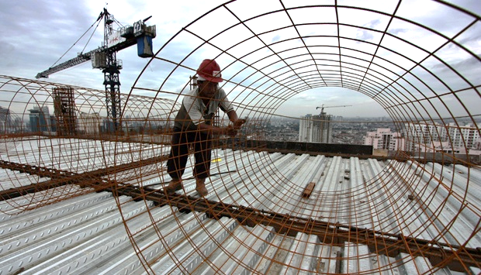

Development of Project in Indonesia
AGUNG JADI PRAKOSO
MINISTRY OF PUBLIC WORKS AND HOUSING OF INDONESIA
UNIVERSITY OF SEOUL

Slide 2
Outline
01
Country Overview
02
Type of Project Development
03
Project Process and Selection
04
Major Project

Slide 3

01
Country Overview

Slide 4

Country Info: Indonesia
266.794.980 people
We are here
17.504 islands
INDONESIA

Slide 5
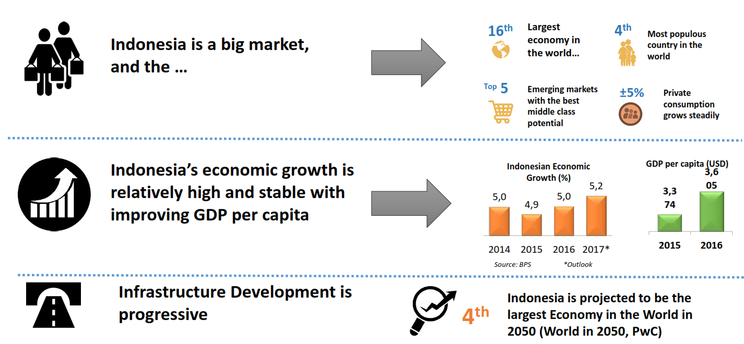
Indonesia: Overview
Source: Bappenas, 2014

Slide 6









Introduction
Infrastructure is Indonesia's highest priority
Travel Time (hrs/100km)
Modal Share (%)
Road Ratio (%)
Hong Kong
25
11
63
0
Tokyo
22%
Malaysia
1.1
China
1.2
Taipei
14
46
20
19
London
21%
Thailand
1.35
Singapore
12%
Vietnam
2
Jakarta 2.3
62.2
12.9
22.6
Indonesia
2.6
Jakarta
6.26%
Rail
Private Transport
Non-Rail Public Transport
Others
Poor quality of roads and high levels of
congestion have made the travel time in
Indonesia the highest in the region,
causing logistics costs to be the highest in the
region.
Lack of government investments in public transport
over the years has resulted in excessive use of
private transport for commuting, thus causing
major congestion in most cities.
Jakarta
has sufficient roads, the reality is the
opposite. General land acquisition problems
Despite the general perception that
combined with severe underinvestment in
roads have caused this bottleneck.
Ratio of Double Track (%)
Dwelling Time (days)
Air Transport Indicators
SHIA
Airport Density
(number per ha)
Connectivity index
Ranking (World)
Ranking (Asia Pacific)
: 652
: 17
: 1
Japan
41.1%
Tanjung Priok
Thailand
Malaysia (Port…
7
5
4
3
2
1
0
China
38.8%
5
Quality of Air
Transport
Infrastructure (WEF
Rank)
India
28.4%
4
Passenger-
kilometers (million
person-km)
UK, Los Angeles…
4
Malaysia
18.0%
Australia, NZ
France
Hong Kong
Singapore
3
3
Malaysia
Thailand
13.4%
Thailand
2
1.1
Vietnam
Indonesia
7.7%
Available airline
seat km/week
Philippines
Cargo (tons-km)
Indonesia
Lack of Double tracking reduces
efficiency of the rail system in the
country – both for freight and passenger
rail services.
A major issue in the seaport sector is
the high dwelling time that currently
takes up to 7 days in Tanjung Priok,
far longer than Thailand (5 days), and
Singapore (1.2 days).
Since the deregulation in 2004, growth in air travel has gone
up double digit per year, but new airport development or
expansion of existing airports has not caught up. For
example, SHIA is designed for 22 mil passengers but
currently handles 55 million passengers per year (9
highest
th
Source: Tusk Advisory Analysis – For
in the world). It is also the most connected airport in Asia
Pacific.
RPJMN 2015-2019
3

Slide 7

Introduction
Infrastructure is Indonesia's highest priority
Indonesia’s GDP Growth (YOY %)
National Budget Allocation (APBN)
Beginning of
Budget
The
commitment in
Reformation the Reformation
20%
10.8%
5.3
450.0
416.1
Education
5.2
5.17
5.18
400.0
20%
375.5
5.1
5.12
350.3
5.05
5.01
350.0
387.3
117.7%
5
5.01
19%
19%
5.01
300.0
Infrastructure
4.9
4.94
4.93
4.92
4.94
4.82
250.0
4.8
4.77
10%
4.7
4.74
200.0
177.9
150.0
5%
54.1%
4.6
104.0
Health
100.0
4%
4.5
67.5
50.0
77.3
4%
77.9%
0.0
The Indonesian economy has grown by 5.01 %
year-on-year in the second quarter of 2017. This
growth was driven by a rebound in government
spending and increase in investment.
2011
2012
2013
2014
2015
2016
2017
Energy
Subsidy
Graphic: Budget allocation (in IDR Trillion)
Number in box: percentage to total APBN
Source: Ministry of Finance, Republic of Indonesia
4

Slide 8
02
Type of Project Development

Slide 9
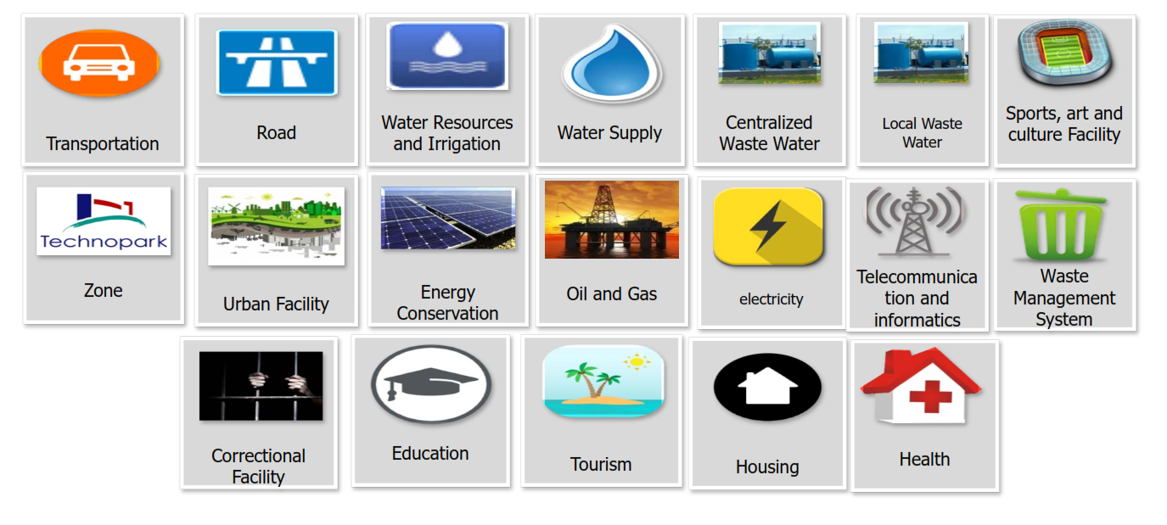
Type of Project
Project with Private Involvement
Source: Presidential Regulation No.38/2015

Slide 10
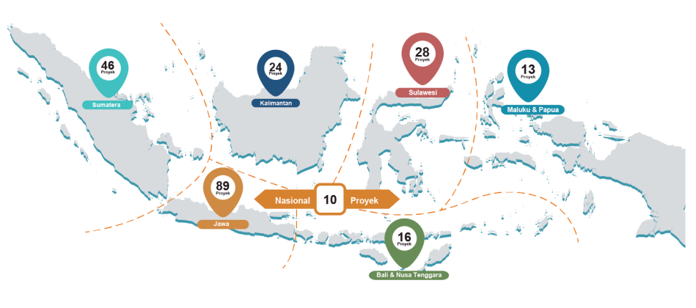
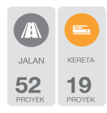
















Government of Indonesia introduced 245 projects and 2 programs as National
Strategic Projects (PSN) with estimated total investment of US$322.8 Billion
27
61
24
Projects
13
Projects
Projects
Projects
Kalimantan
Sulawesi
Sumatra
US$11.9 B
Maluku & Papua
US$49.1 B
US$43.3 B
US$34.2 B
93
1
Projects
2
Programs
National
10
Proyek
Projects
Java
12
Projects
US$81.9 B
US$101.5 B
15
Bali &
Nusa Tenggara
US$0.8 B
PSN includes 15 sectors at project level and 2 sectors at program level
Project
WATER &
-
NOLOGY
INDUSTRI-
AL ZONE
IRRIGA
-
TECH
SMELTER
OIL
REFINERY
FISHERY
ROAD
RAILWAY
SEAPORT
AIRPORT
HOUSING
HOUSING
SANITA-
TION
DAM
IRIGASI
SEA DIKE
TION
74 23 10
30
54
7
4
12
1
8
3
3
9
7
6
1
Projects
Projects
Projects
Projects
Projects
Projects
Projects
Projects
Projects
Projects
Projects
Projects
Projects
Project
Project
Program
Electricity
1
PROGRAM
Small-
Medium
Airplane
1
PROGRAM
Exchange rate: US$ 1 = IDR 13,000

Slide 11
In addition, KPPIP has selected 30 Priority Projects out of the PSN, that will be
revised to be 37 priority projects
The Government of Indonesia has also issued the Coordinating Ministry of Economic Affairs Regulation No.
12/2015 to stipulate 30 priority projects which will potentially be revised to 37 priority projects
4
24
4
22
14
23
4
24
4
27
2
24
15
18
4
23
4
24
24
24
12
23
1
18
4
22
23
23
30
24
18
18
22
25
27
18
18
22
27
24
24
31
18
4
4
11
23
24
37
18
18
24
4
4
36
7
34
9
18
#
New Priority Projects
3
13
8
10
16
33
27
24
37
17
21
13
19
32
20
24
26
29
#
Existing Priority
Projects
37
35
20
27
6
37
5
37
28
37
24
24
24
1. Balikpapan-Samarinda Toll Road
2. Manado-Bitung Toll Road
3. Panimbang-Serang Toll Road
4. 15 Segments of Trans Sumatera Toll Road
5. Probolinggo-Banyuwangi Toll Road
6. Yogyakarta-Bawen Toll Road
7. SHIA Express Railway
8. MRT Jakarta North – South Line
9. Makassar – Parepare Railway
10.Light Rail Transit (LRT) of Jakarta, Bogor,
Depok and Bekasi
11.Light Rail Transit (LRT) of South Sumatera
12.East Kalimantan Railway
13. Light Rail Transit (LRT) of DKI Jakarta
14. Kuala Tanjung International Hub Seaport
15. Bitung International Hub Seaport
16. Patimban Port
17. Inland Waterways/Cikarang – Bekasi – Laut
(CBL)
18. Palapa Ring Broadband
19. Central Java Power Plant (CJPP)
26. Tuban Oil Refinery
27. RDMP/Revitalization of Existing Oil Refineries
(Balikpapan, Cilacap, Balongan, Dumai, Plaju)
28. Abadi WK Masela Field
29. Unitization Field Has Jambaran-Tiung Biru
30. Indonesian Deepwater Development (IDD)
31. Tangguh LNG Train 3 Development
32. West Semarang Drinking Water Supply
20. Central – West Java Transmission Line 500 kV 33. Jakarta Sewerage System
21. Indramayu Coal-fired Power Plant
22. Sumatera 500 kV Transmission (4 Provinces)
23. Mulut Tambang Coal-fired Power Plant (6
Provinces)
24. PLTGU (16 Provinces)
25. Bontang Oil Refinery
34.
National Capital Integrated Coastal
Development (NCICD) Phase A
35. Jatiluhur Drinking Water Supply
36. Lampung Drinking Water Supply
37. Waste to Energy Program in 8 Cities
Text in blue are New Priority Projects

Slide 12

THERE ARE ALSO SECTOR SPECIFIC CHALLENGES IN INDONESIA
Challenges
Key challenges limiting
infrastructure investment
Toll Roads and Bridges
Land acquisition
Maturity mismatch
Inadequate project preparation
Public roads
No mechanism for PPP
Railways
PSO-IMO-TAC framework does not allow financial feasibility with current level of accounting detail
No independent regulator
Existing infrastructure dated: load handling cannot compete with road
Water supply
Challenging local government approval process
Lack of commitment and support towards central government initiated project
Airports
Low airport profitability due to politicised tariff setting process
Land acquisition challenges
Lack of expertise in airport operation
No independent regulator
Irrigation and waterways
No legislation supporting PPP
Indonesia Infrastructure Development
Power
Investor caution due to post-1998 price renegotiations
PLN monopoly in transmission, distribution, sales
Lack of differentiated tariff structure
Ports
No differentiated tariff structure
No independent regulator
Lack of competition, restrictions on foreign involvement
Lack of natural deep water harbours
Waste
Regulatory framework only favours waste to energy
Telecoms
No independent regulator
Oil and gas
Declining oil production
Little or no history of PPP
Even though regulatory framework has opened access for private participation, most of the infrastructure sub-sector remain dominated by State Owned Enterprises (SOEs)
Source: Morgan Stanley Infrastructure Report; BCG Analysis

Slide 13
Role of Institution
Ministry of Transportation
Business License of Sea Transport Company/SIUPAL
Publishing Operation License of Sea
Transport Company (SIOPSUS)
Establishment of business entity port
Business License salvage company and underwater works
Business License of Recruitment
and Placement Crew (IUPPAK)
Business license of airport commercial (permit business entity airport)
Business license of air transport
Ministry of Public Works & Public Housing
Ministry of Energy & Mineral Resources
Electrical power supply business license
Operating Permit (Operation worthy Certificate – SLO)
Determination of business area
Electrical power supporting service business license
Cross country power sale purchase license
Permit for utilization of electrical power grid for telecommunication, multimedia, and informatics
Assignment of geothermal preliminary survey (PSP)
Geothermal license
Geothermal supporting business
approval
Geothermal explosive warehouse utilization permit
Investment permit in the field of toll road management business
Investment permit in the field of drinking water management business
Business license for property development and business
Business license of foreign construction service
Business license of foreign construction consulting service
Business license for housing
sector
Permit for Foreign Construction Service Business Entity Representative/BUJKA
Ministry of Land and Spatial Planning/BPN
1. Recommendation for application of
land right
13

Slide 14
03
Project Process and Selection

Slide 15
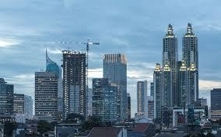

Main Trends
Indonesia's construction and projects market is growing and is predicted to continue to strengthen, which has shown a tendency to focus on transportation and energy-related infrastructure.
While in the past construction and projects tended to be concentrated in western Indonesia, and on Java Island in particular, President Jokowi has expressed his intention to prioritise the development of eastern Indonesia, including Kalimantan, Nusa Tenggara, Maluku and Papua.
The government has also indicated that it wants to encourage private parties to participate in infrastructure projects through various forms of co-operation, including public-private partnership (PPP) schemes.

Slide 16
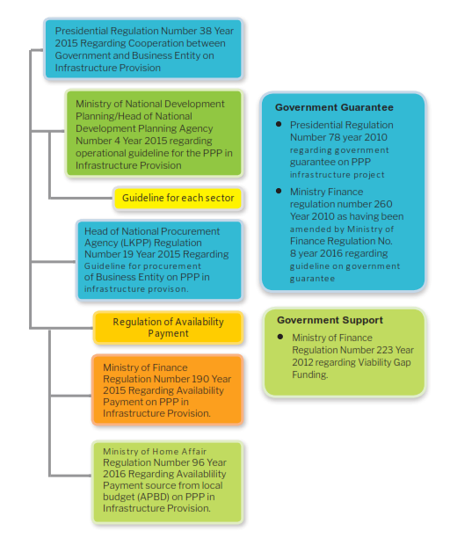
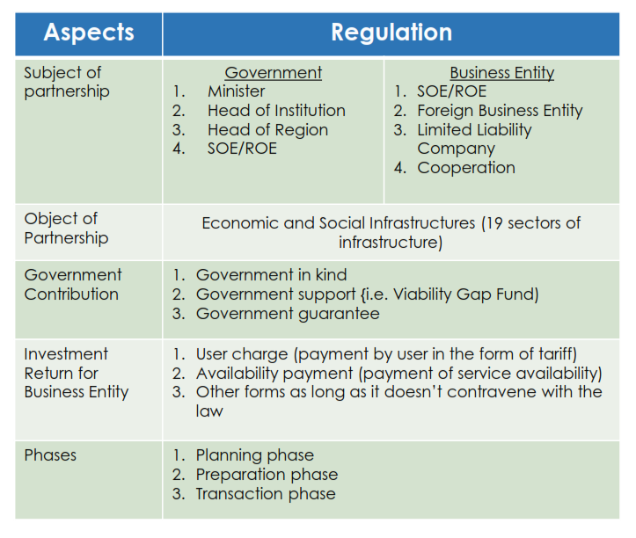
Regulation
Source: PPP Infrastructure Project Plan in Indonesia 2018 (Bappenas 2018)

Slide 17



Policy Reforms
TO ACCELERATE INFRASTRUCTURE DEVELOPMENT
1. Fiscal Reforms
2. Institutional Reforms
1) Viability Gap Funding (VGF)
1) KPPIP
4) PPP Unit
Increase project financial feasibility by
contributing up to 49% of the
construction cost. (MoF Reg. No.
223/2012).
KPPIP
is actively involved in accelerating
Provide facilities to help GCA on preparing
delivery of priority infrastructure projects.
PPP project (PDF/TA).
2) PT Sarana Multi Infrastruktur
5) BLU LMAN
A merger between PT SMI and Gov’t
Investment Center (PIP) to become an
infrastructure funding company.
The State Asset Management Agency (BLU
LMAN) is mandated to provide land fund for
National Strategic Projects to ensure timely
2) Availability Payment
Issuance of regulatory framework to
allow annuity payment by the Gov’t
during concession period to
concessionaire since project operation
based on infrastructure service
availability. (MoF Reg. No. 190/2015 j.o.
MoF Reg. No. 260/2016 for Central
Gov’t and MoHA Reg. No. 96/2016 for
Regional Gov’t).
3
)
PT Indonesia Infrastructure
land acquisition
process.
Finance (IIF)
6) Indonesia Infrastructure
PT Indonesia Infrastructure (IIF) provides
capital for infrastructure development and
support the GCA in the preparation and
transaction stages for PPP projects).
Guarantee Fund (IIGF)
IIGF has the potential to provide project
guarantee for non-PPP projects.
3. Regulatory Reforms
3) Risk-sharing Guidelines
1) Direct Lending
2) Land Acquisition
3) Economic Policy
Packages
IIGF has issued risk allocation and
mitigation guidelines for PPP project.
Allow guarantee for direct
lending to SOE to accelerate
financial close process for
infrastructure projects.
(Presidential Reg. No.
82/2015.).
Stipulate land acquisition
acceleration based on Law
No. 2/2012. (Presidential
Reg. No. 148/2015).
Conduct deregulation for issues
hindering infrastructure delivery
and develop a task force under
CMEA to ensure the
implementation’s effectiveness
of Economic Policy Packages.
8

Slide 18
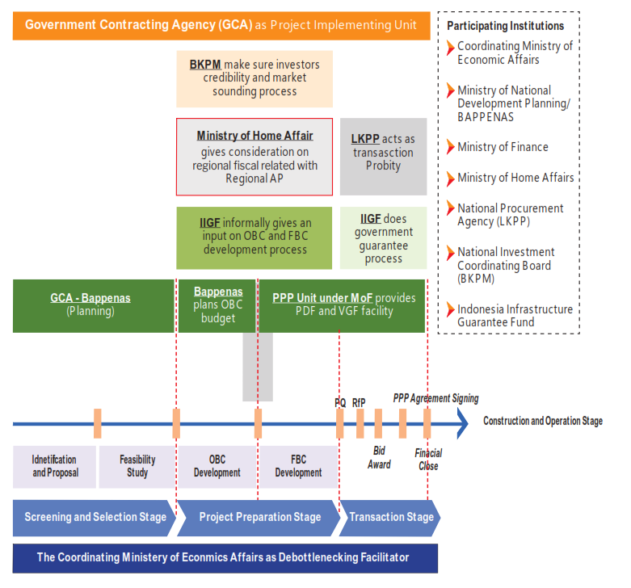
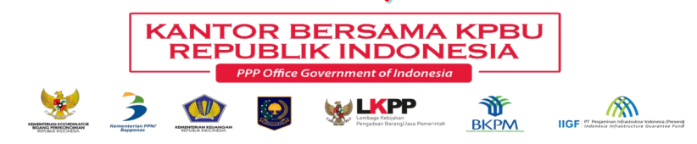
Institution
BKPM : Investment Coordinating Board
IIGF : Indonesia Infrastructure Guarantee Fund
Bappenas : Ministry of National Development Planning
MoF : Ministry of Finance
LKPP : National Procurement Agency
PQ : Pre-Qualification
RfP : Request for Proposal
OBC : Outline Business Case
FBC : Final Business Case
AP : Available Payment
Source: PPP Infrastructure Project Plan in Indonesia 2018 (Bappenas 2018)

Slide 19
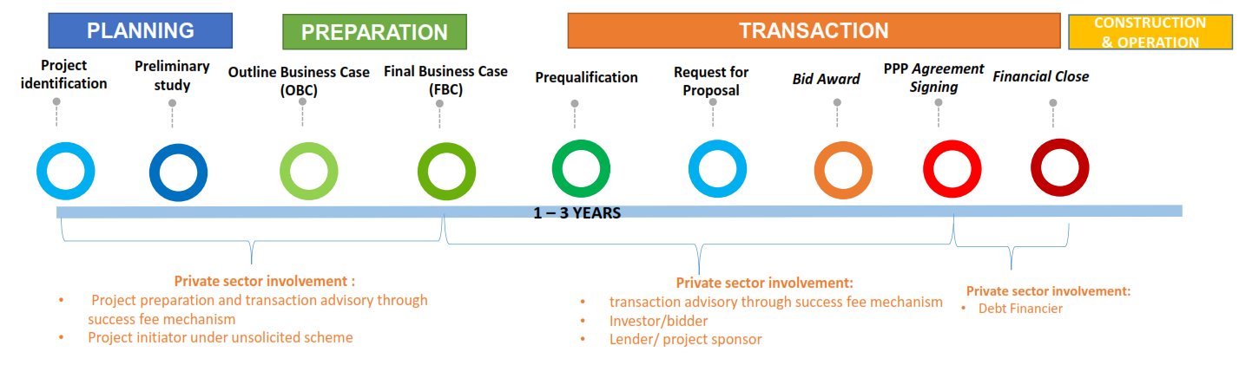
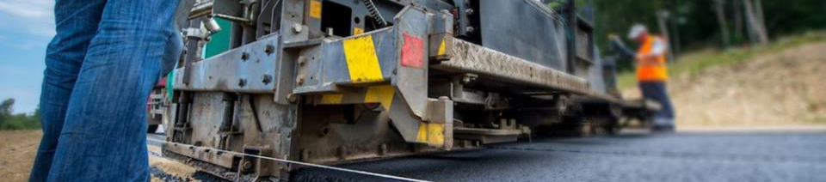
Process: Solicited Project
Source: PPP Infrastructure Project Plan in Indonesia 2018 (Bappenas 2018)

Slide 20
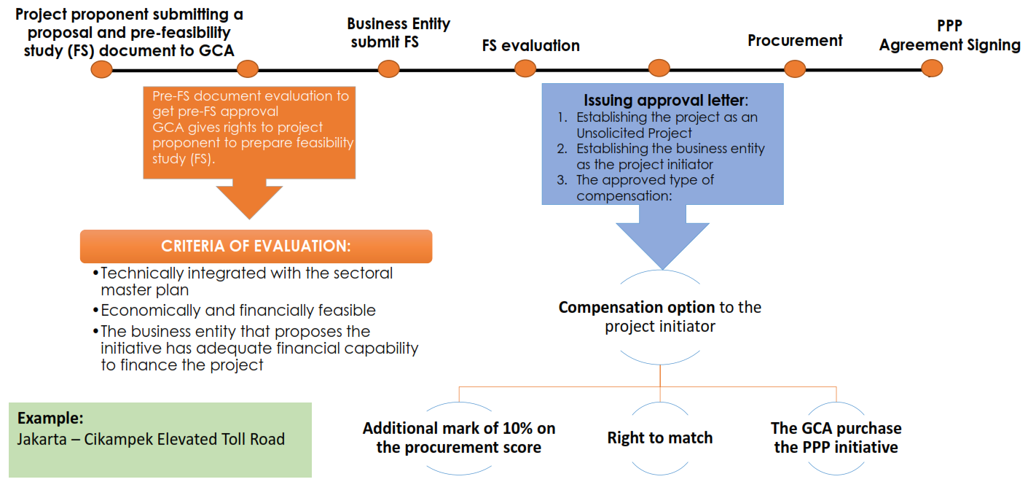
Process: Unsolicited Project
Source: PPP Infrastructure Project Plan in Indonesia 2018 (Bappenas 2018)

Slide 21
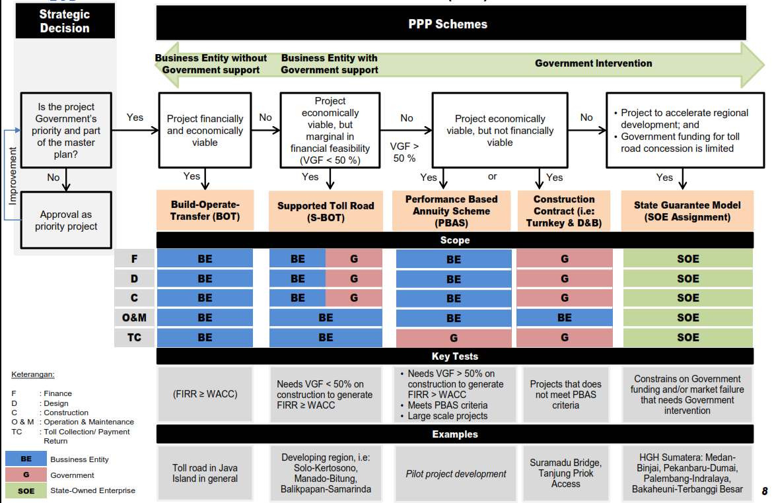
PPP Scheme
Source: Indonesia Toll Road Authority, 2015

Slide 22
Participation of Private Sector in Infrastructure
 | Port | Airport | Railways
Participation of private sector | Port concessions shall be granted to port business entities through a tender mechanism (refers to Pres Reg 13/2010). The maximum concession period is 30 years as of signing date of the concession agreement. (Gov Reg 61/2009) | In determining private partner, the government will hold an open tender. Concession period will be determined based on the calculation of investment return and fair profit to the business entity. | In determining private partner, the government will hold an open tender. The business permit from MoT will valid for a period 30 years and can extended for maximum of 20 years (Gov Reg 56/2009)
Various business model | Refers to Gov Reg 61/2009, threre 3 possible cooperation: BOT (Build-Operate-Transfer) BLT (Build-Lease-Transfer) ROT (Rehabilitate-Operate- Transfer) | Law 1/2009 introduces several forms of cooperation: BOO (Build-Operate-Own) BOT (Build-Operate- Transfer) Contract Management | Law 23/2007 introduces several forms of cooperation: DBB (Design – Bid – Build) BOT (Build-Operate-Transfer) BOO BOO (Build-Operate-Own) DBFO (Design-Build-Finance- Operate)
Tariff setting | Tariff of port services managed by a port business entity is determined by port business entity itself based on the type, structure and category of tariff stipulated by the government (Law 17/2008) | Airport business entities may determine tariff charges after consulting with the Minister of Transportation (Gov Reg 70/2001) | Law 23/2007, government will stipulate tariff guidelines for railways charges based on capital, calculation, operational cost, maintenance cost and profit calculation

Slide 23
Public Private Partnership in Indonesia
Facilities for PPP Infrastructure Projects
GOVERNMENT GUARANTEE | Government Guarantee is provided by Minister of Finance through Indonesia Infrastructure Guarantee Fund (IIGF)/PT Penjaminan Infrastruktur Indonesia (PT PII). Government Guarantee is given: To provide a political risk guarantee for PPP Infrastructure Projects To improve creditworthiness of PPP projects To attract more private sector participation, due to reduced risk perception of Indonesia PPPs Risk Coverage: Delay or failure in obtaining licenses, permits, and approvals; Changes in laws/regulations; Breach of contract; Integration with network; Tariff risk; Expropriation risk; Currency inconvertibility & non-transfer risk; Force majeure affecting the Contracting Agency (CA)
GOVERNMENT SUPPORT | Government may provide support in the form of licensing, land acquisition, part of construction, and/or in other form in accordance with prevailing law and regulation Minister of Finance may approve the provision of Government Support in the form of tax incentives and/or fiscal contribution in the form of financial based on the proposal by Minister/Chairman of the Institution/Head of Region. Government support has to be secured prior to the issuance of the RFP (prior to bid submission for land acquisition) Examples: Viability Gap Fund (VGF), Land Fund, Geothermal Fund, Permits and Licensing, Land acquisition, Use of State Assets
PROJECT PREPARATION | Providing advice to Government Contracting Agency through PT. Sarana Multi Infrastruktur (PT. SMI) for preparing of pre-feasibility study; peparing of tender documents; providing assistance during the tender process; and providing support towards realization of financial close
FISCAL INCENTIVES | Tax allowance are eligible to infrastructure and renewable energy; Tax Holiday are eligible to Oil Refinery project Geothermal Fund Feed in Tariff (Hydropower Energy, Solar Energy, and Solid Waste to Energy)

Slide 24
04
Major Projects
and Construction Companies

Slide 25
Major Projects
Noteworthy projects in Indonesia include a number of major government-sponsored infrastructure projects:
Land transportation: Mass Rapid Transit (MRT) project in Jakarta, and Light Rail Transit (LRT) projects in Palembang, the capital of South Sumatra, and Jakarta.
Toll roads: The Trans-Sumatra toll road in Sumatra, and the Manado-Bitung toll road in North Sulawesi.
Seaports: The Kuala Tanjung International Hub Port in North Sumatra, and the Bitung International Hub Port in North Sulawesi.
Airport: Kertajati Airport in West Java.
Energy: Karangkates IV & V hydroelectric power plants in East Java, and the 500 kilovolt electricity transmission grid in Sumatra.

Slide 26

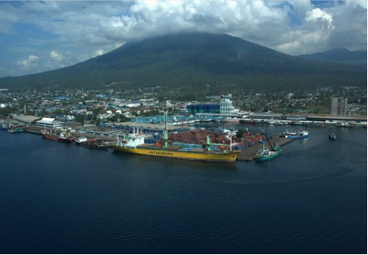


Selected Project Updates
Bitung International Hub Port
Location
North Sulawesi
Investment Value
Estimated US$ 2.55 billion
1
Funding Scheme
Potentially PPP (to be determined)
Contact
Person/Project Owner
rip.sd1pelpeng@gmail.com/
Ministry of Transportation
Estimated
Concession Period
Not yet determined
Target Construction
Estimated in 2020
Target Operation
Estimated in 2022
Description
Latest Status
• The development of an International Hub Seaport
in Bitung, North Sulawesi, to support the
development of Bitung SEZ. The International Hub
Seaport will also support the industrial activities in
East Indonesia, including Ambon and Ternate
(Agriculture, Manufacturing, and Mining), and
Samarinda, Balikpapan, Tarakan, and Nunukan
(Coal, Oil, and Plywood).
• Currently in the tender process for OBC consultant, facilitated
by KPPIP. The OBC will analyze the integration of the existing
port, Bitung SEZ, and Lembeh Island.
• Land acquisition will be started after the completion of the OBC.
• Private sector has the potential to participate as developer and
operator of the port and terminal. The private role will be
defined based on the OBC.
• In 2034, the capacity is planned to be up to 2.25
Million TEUs.
• PT Pelindo IV is currently developing the existing port in Bitung.
1
) USD: IDR 13,000
18

Slide 27
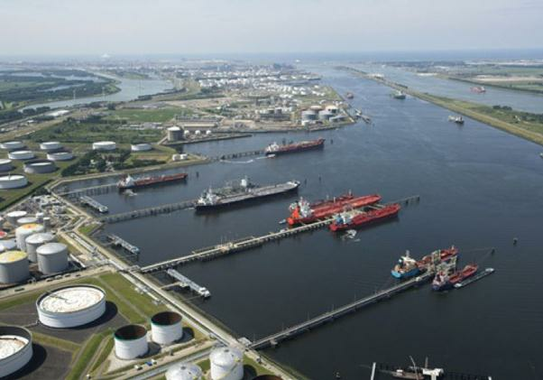


Selected Project Updates
Kuala Tanjung International Hub Port
Location
North Sumatra
Investment Value
Estimated US$ 2.25 billion (Phase II)
1
Funding Scheme
Landlord model via assignment to
Pelindo I (to be determined)
Contact
Person/Project
Owner
rip.sd1pelpeng@gmail.com/
Ministry of Transportation
Estimated
Concession Period
Not yet determined
Target Construction
Estimated in mid 2019
Target Operation
Estimated in 2021
Description
Latest Status
• The development of an international hub seaport
as the gateway to Western Indonesia. The port is
expected to serve transshipment cargo by 2.3
million TEUs in 2030.
• The Outline Business Case (OBC) has been completed and
distributed to stakeholders. The OBC’s objective is to ensure the
planning and preparation of the project meets the criteria and
depth of study that is accepted by the market, and also provide
recommendation on port area and regional infrastructure
development.
• The International Hub Port is expected to
accommodate captive and transshipment cargos
from international and domestic, especially from
and to Sei Mangkei SEZ and Kuala Tanjung
Industrial Zone.
• Private sector can participate as developer and operator of the
port, terminal and industrial zone. The land including industrial
zone is currently being acquired by the Pelindo I through its
subsidiary.
1
) USD: IDR 13,000
19

Slide 28



Selected potential projects for private investment
Yogyakarta – Bawen Toll Road
Location
Yogyakarta – Central Java
Investment Value
Estimated USD 911.4 Million
Funding Scheme
Potential for PPP
Contact
Person/Project
Owner
investasi2.bpjt@gmail.com/Ministry of
Public Works and Public Housing
Estimated
Concession Period
Not yet determined
Target
Construction
Estimated in 2018
1
) USD: IDR 13,000
Target Operation
Estimated in 2020
Description
Latest Status
• The Yogyakarta - Bawen Toll Road is expected to
support tourism around Yogyakarta, Semarang,
and Solo, especially The Borobudur Temple. This
toll road will connect the existing toll road,
Semarang – Solo Toll Road with the Special
Region of Yogyakarta.
• The feasibility study of Yogyakarta – Bawen Toll Road has been
completed in 2008. But, it needs to be redeveloped to
accommodate the updated information. Thus, KPPIP is
currently preparing the Outline Business Case (OBC) which will
be completed in December 2017.
• The funding scheme for the construction of Yogyakarta – Bawen
is potential for PPP. However, the funding scheme
determination will be based on the OBC result.
• Based on the study, the toll road will be 71,56 km
with the expected average daily traffic amounted
to 16,322 car/day.
20

Slide 29
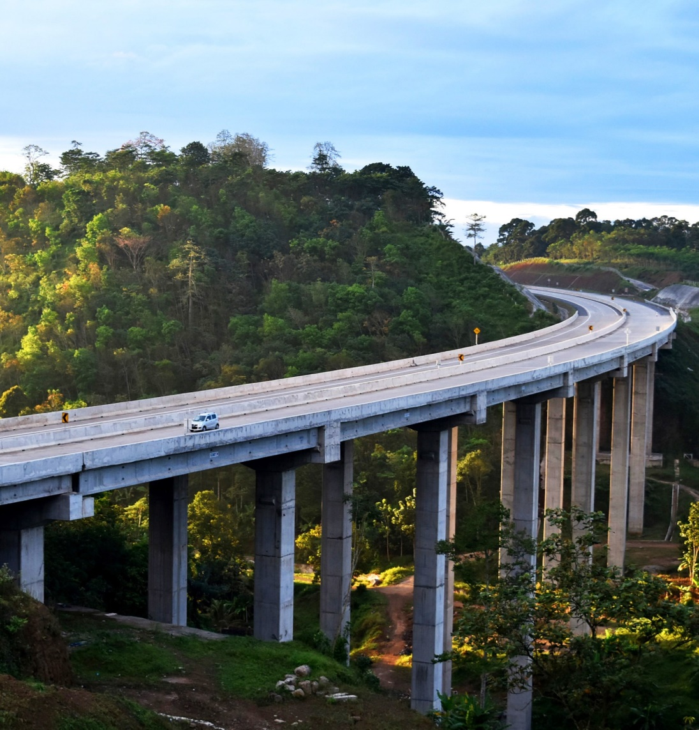
Construction Company (1)
STATE-OWNED ENTERPRISES DOMINATE INFRASTRUCTURE SEGMENT
State-controlled companies have long played and continue to play an important role in Indonesia's construction industry, with Wijaya Karya (WIKA), Waskita Karya, Pembangunan Perumahan (PP), and Adhi Karya ranking among the largest players in the industry.
State-owned enterprises are more successful in being awarded public-sector contracts than their private competitors and have displayed a strong financial performance in recent years thanks in large part to public infrastructure development.

Slide 30
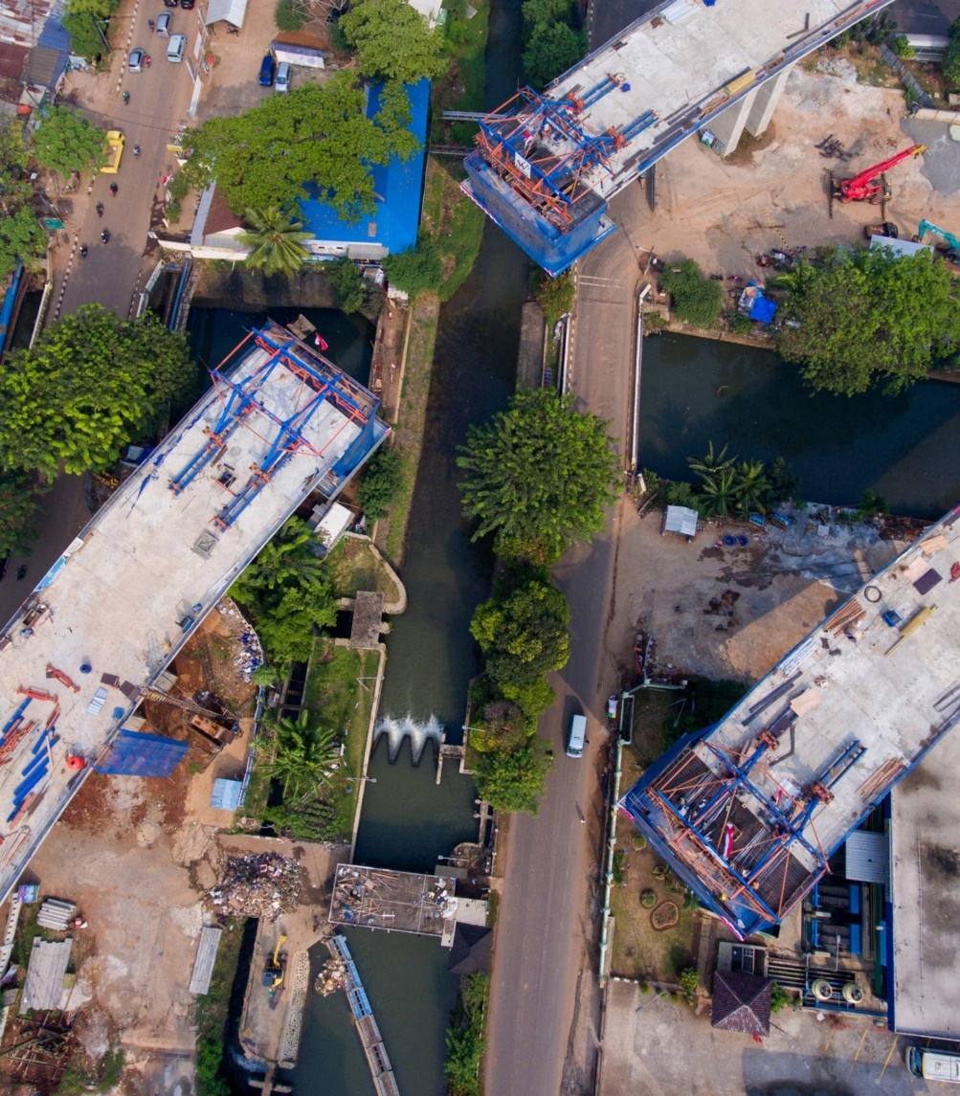
Construction Company (2)
LIST OF 10 BEST
PT Adhi Karya (Persero) Tbk.
PT Wijaya Karya
PT PP (Persero) Tbk.
PT Waskita Karya
PT Amarta Karya
PT Brantas Abipraya
PT Hutama Karya
PT Leighton Contractors Indonesia
PT Nindya Karya
PT Total Bangun Persada Tbk.

Slide 31
Construction Organizations
Construction Services Development Institution (Lembaga Pengembangan Jasa Konstruksi) (LPJK)
www.lpjk.net
LPJK is authorised to register construction service business entities and construction professionals, and to issue related certification.
Indonesian Contractor Association (Asosiasi Kontraktor Indonesia) (AKI) www.aki.or.id
AKI was established in the 1970s and is one of Indonesia's best-known construction associations. It has been appointed by the LPJK as its representative in processing SBU applications.
Indonesian National Construction Implementation Association (Gabungan Pelaksana Konstruksi Nasional Indonesia) (GAPENSI)
www.gapensi.or.id
GAPENSI is one of the oldest and best-known construction associations in Indonesia, having been established in the 1950s. It has been appointed by the LPJK as its representative in processing SBU applications.

Slide 32
Market Outlook: Indonesia
By studying the progress that has been achieved by the Korean and other East Asian Nations, I believe that Indonesia can progress and develop infrastructure effectively and efficiently applying the rules of construction management.
Projected by improving Indonesia's ability to build by applying good governance, in the next 10 years it will require investment of infrastructure worth 400 bilion USD.
When calculated Construction Management consultancy portion of 3% of investment value, the portion of CM in the next 10 years in Indonesia is around 12 billion USD.
The above targets can only be achieved if the Indonesian government succeeds in increasing the income from taxes with a 10% increase per year which is mainly generated from the process of increasing the added value of mining, agriculture, fishery and labor services abroad.

Slide 33
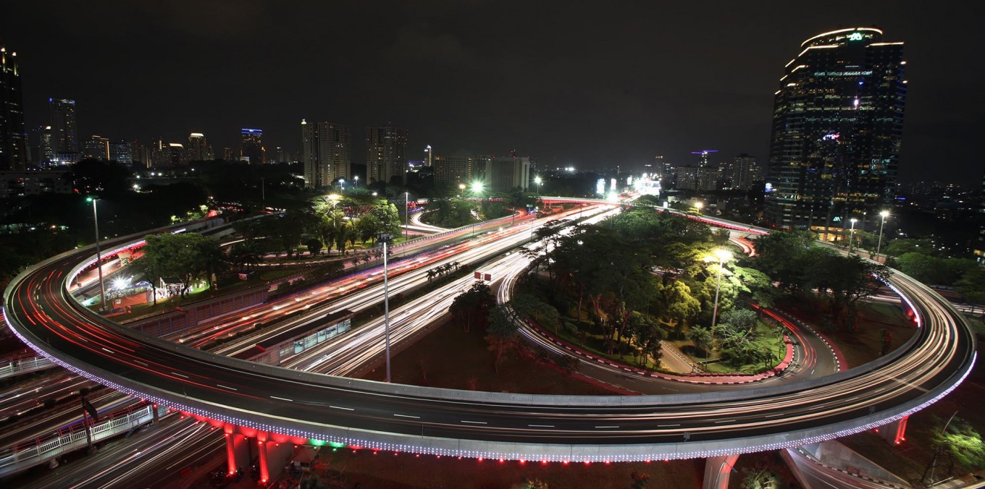
THANK YOU
Agung Jadi Prakoso|
Ministry of Public Works and Housing|
University of Seoul|
prakoso75@gmail.com|

Slide 34
Government’s Role
and Policy

Slide 35
Role of Institution
Ministry of Transportation
Business License of Sea Transport Company/SIUPAL
Publishing Operation License of Sea
Transport Company (SIOPSUS)
Establishment of business entity port
Business License salvage company and underwater works
Business License of Recruitment
and Placement Crew (IUPPAK)
Business license of airport commercial (permit business entity airport)
Business license of air transport
Ministry of Public Works & Public Housing
Ministry of Energy & Mineral Resources
Electrical power supply business license
Operating Permit (Operation worthy Certificate – SLO)
Determination of business area
Electrical power supporting service business license
Cross country power sale purchase license
Permit for utilization of electrical power grid for telecommunication, multimedia, and informatics
Assignment of geothermal preliminary survey (PSP)
Geothermal license
Geothermal supporting business
approval
Geothermal explosive warehouse utilization permit
Investment permit in the field of toll road management business
Investment permit in the field of drinking water management business
Business license for property development and business
Business license of foreign construction service
Business license of foreign construction consulting service
Business license for housing
sector
Permit for Foreign Construction Service Business Entity Representative/BUJKA
Ministry of Land and Spatial Planning/BPN
1. Recommendation for application of
land right
35

Slide 36
Reformations along the project life cycle aim to encourage and accelerate infrastructure projects using the Public Private Partnership (PPP) scheme
GOVERNMENT OF INDONESIA
Project Development Facility (PDF)
Viability Gap Funding (VGF)
Guarantee Fund
Tax Facilities
Availability Payment
Land Acquisition
Preparation
Bidding Process
Construction
A facility contributing to assist GCA on PPP project preparation (PDF&TA)
Managing entity: KPPIP, PT
SMI and PT IIF, Ministry of Finance under its new PPP Unit
A facility with contribution to construction cost to increase project financial viability
Managing entity: Ministry of
Finance based on GCA proposal Govt’s commitment: 49% max per project
Guaranteeing government's contractual obligations under infrastructure concession agreements
Managing entity: Indonesia Infrastructure Guarantee Fund (IIGF) – wholly owned by MoF
Govt’s commitment: US$ 450 Mil
MoF Reg. No. 159/PMK.010.20
15 re: tax holiday for pioneer sector, such as base metal, oil refinery, basic petrochemical, machinery, renewable energy, & telco equipment industries, which will be further expanded.
Managing entity: Ministry of Finance
A scheme in which concessionaire receive sum of money periodically from government after the completion of an asset.
Ministry of Finance Regulation on Availability Payment has been ratified.
Managing entity: Ministry of Finance
A facility to support land acquisition for infrastructure projects particularly on the private sector projects.
Managing entity: Ministry of Finance; Ministry of Agrarian and Land Spatial/BPN
Govt’s commitment: US$ 12 Mi (only for 2016)
36

Slide 37
Institutional Framework to Support PPP
Government of Indonesia
Private Sectors
Legal and Regulatory Framework
Land Fund
Guarantee Fund (PT PII)
Regulatory Reform and capital market
Infrastructure Fund
PT SMI |  | PT IIF
Investor/ Lender
Land Acquisition
Cost recovery/ Political Risk
Project Financing
Preparation
Bidding Construction Operational
PT SMI = PT Sarana Multi Infrastruktur (Persero); PT IIF = Indonesia Infrastructure Finance; PT PII = PT Penjaminan Infrastruktur Indonesia

Slide 38
Construction Industry
in Indonesia

Slide 39
Relevant Law
Presidential Regulation No. 39 of 2014 on the Negative Investment List reserves low-technology and low-risk construction services for local SMEs and cooperatives. (Updated in Presidential Regulation number 44 of 2016)
Foreign companies can establish representative offices in Indonesia and execute complex, large scale, and high-technology projects in partnership with local companies, Minister of Public Works Regulation No. 10/PRT/M/2014 provides the guidelines.
Procurement arrangements cannot be generalised, as certain business sectors have their own particular procedures and regulations. For example, procurement arrangements for construction related to upstream oil and gas infrastructure are regulated by the Second Book of PTK 07/SKKMA0000/2017/SO issued by SKK Migas, a special government work unit overseeing the upstream oil and gas sector.

Slide 40
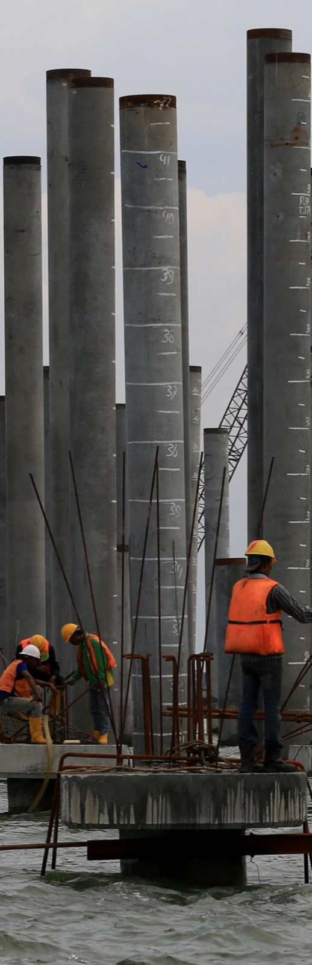
Relevant Law
Regarding the issuance of the new negative investment list 2016 based on Presidential Regulation number 44 of 2016 on sectors closed or partially closed to foreign investment in Indonesia (New Regulation). The column is discussing the limitations for construction companies in the new negative investment list 2016.
In general the New Regulations amends the limitations towards foreign investors that wish to be active in the field of public works construction in Indonesia as follows:
Construction implementation companies (contractors) and construction consulting companies which are using high technology and/or high risk and/or with a work value of more than 50 billion rupiah. These companies may hold maximum 67% foreign shareholder (for ASEAN countries, the maximum is set at 70%).
Based on our understanding construction consulting companies that are using high technology and/or high risks and/or have a work value of more than 10 billion rupiah but less than 50 billion rupiah are under the New Regulation open for 100% for foreign investors.

Slide 41
If construction business is carried out by individuals, an Individual Business Registration Licence (Tanda Daftar Usaha Perseorangan) (TDUP) is required. The TDUP is issued by the regency/city government.
If construction business is carried out by an Indonesian business entity (including for a PT PMA), a Business Entity Certificate (Sertifikat Badan Usaha) (SBU) and a Construction Services Business Licence (Izin Usaha Jasa Konstruksi) (IUJK) are required. An SBU is issued by the Construction Services Development Institution (Lembaga Pengembangan Jasa Konstruksi) (LPJK) through a construction association appointed by the LPJK as its representative. For local business entities, an IUJK is issued by the regency/ city regional government for local companies. For PT PMAs, these are issued by the Capital Investment Coordinating Board (Badan Koordinasi Penanaman Modal) (BKPM).
If construction business is carried out by a BUJKA representative office, the relevant licence must be obtained from the BKPM.
Construction professionals must obtain a Work Competence Certificate, under the Construction Law. The Work Competence Certificate is obtained after passing a competence test and is issued by the relevant professional certification institution.
What licenses and other consents must contractors and construction professionals have to carry out local construction work? Are there any specific licensing requirements for international contractors and construction professionals?

Slide 42
What licenses and other consents must a project obtain? (1)
Before
Licences that must be obtained before construction commences include the following:
Land Utilisation Permit (Izin Peruntukan Penggunaan Tanah).
Building Construction Permit (Izin Mendirikan Bangunan).
Environmental Permit (Izin Lingkungan).
Technical approvals and recommendations must also be obtained from the relevant government institutions. These licenses, approvals and recommendations are generally obtained from the regional government. There may be small differences in the licenses, approvals and/or recommendations required from region to region, due to differences in the provisions of the relevant regional government regulations and adopted policies.

Slide 43
During
During construction works, some of the necessary licences require the licence holder to submit periodical reports to
the relevant regional authorities. For example, following the issuance of an IUJK, a PT PMA must submit a Capital Investment Activities Report (commonly known as an LKPM) every semester on its investment activities. If there is a change in design or construction layout, the licence may need to be updated or revised.
On completion
In some regions, a Certificate of Worthiness (Sertifikat Laik Fungsi) is required after the completion of construction.
The regional government may also impose periodical reporting requirements and conduct periodical inspections to monitor the facility/building being constructed.
What licenses and other consents must a project obtain? (2)

Slide 44
What are the main requirements for hiring local and foreign workers?
Local workers
Local workers can be employed on the basis of either a fixed-term employment agreement or an indefinite term
employment agreement. For a fixed-term employment agreement, the period of work may be based on either:
A certain specified time period.
The completion of certain works.
Foreign workers
An employer who employs foreign nationals must obtain a work permit (Izin Menggunakan Tenaga Kerja Asing)
(IMTA) from the Ministry of Manpower (MOM) to allow the foreign nationals to work in Indonesia. To obtain an IMTA, the employer must prepare a Plan for the Utilisation of Foreign Workers (Rencana Penggunaan Tenaga Asing) (RPTKA) and have it endorsed by the MOM.
Foreign nationals must obtain a Work Permit and a Stay Permit (KITAS). Not all work positions are open to foreign nationals. Human resources directors and other positions set out by Ministry of Manpower and Transmigration decree are closed to foreign nationals. The MOM is currently revising the regulation concerning the procedure for obtaining a work permit and it is possible an Indonesian language test will be introduced as a requirement for foreign nationals seeking a work permit.

Slide 45
Which local laws regulate projects' effects on the environment?
Law No 32 of 2009 regarding Environmental Protection and Management (Environmental Law) is a general law related to the environment. In addition to the Environmental Law, the following further laws and regulations may also be relevant.
Air
Government Regulation No. 41 of 1999 regarding Air Pollution Control.
Water
Law No. 11 of 1974 regarding Water and Government Regulation No. 121 of 2015 regarding Water Resources
Utilisation.
Waste
Law No. 18 of 2008 regarding Waste/Garbage Management and Government Regulation No. 101 of 2014 regarding
Hazardous and Poisonous Waste Management, specifically if the waste is hazardous or poisonous.
Environmental impact assessments (EIAs)
Government Regulation No. 27 of 2012 regarding Environmental Permits, and Minister of Environment Regulation
No. 5 of 2012 regarding Business Lines and/or Activities that Require an Environmental Impact Assessment (Analisis Mengenai Dampak Lingkungan Hidup) (AMDAL).
Sustainable development
Presidential Regulation No. 59 of 2017 regarding Implementation of Sustainable Development Goals.

Slide 46
Are there any proposals to reform construction and projects law?
The Construction Law was recently issued on 12 January 2017, revoking Law No. 18 of 1999 regarding Construction Services (Law 18/1999). The Construction Law mandates the enactment of implementing regulations containing more detailed provisions within the two years after its enactment. In the absence of a new implementing regulation, the implementing regulations for Law 18/1999 remain in effect, in so far as the provisions are not contrary to the Construction Law. There are still a number of implementing regulations of the Construction Law that have not yet been issued, such as an implementing regulation that further governs construction work contracts. There may be further reforms to construction and projects law with the issuance of these implementing regulations.

